Slide 1

Financial report
JEDIDIAH SOLOMON

Slide 2
Financial Report and it Purpose
Financial reporting is intended to help track a business’s income, cash flow, profitability, and overall viability in the long run.
02
Financial report gives the business activities and financial performance of a company or a product
01

Slide 3
What this Presentation Entails..
Financial report on a company’s performance based on it:
Products
Countries
Sectors
Monthly trend
Actionable insights from the report
Recommendations based and the insights gotten

Slide 4
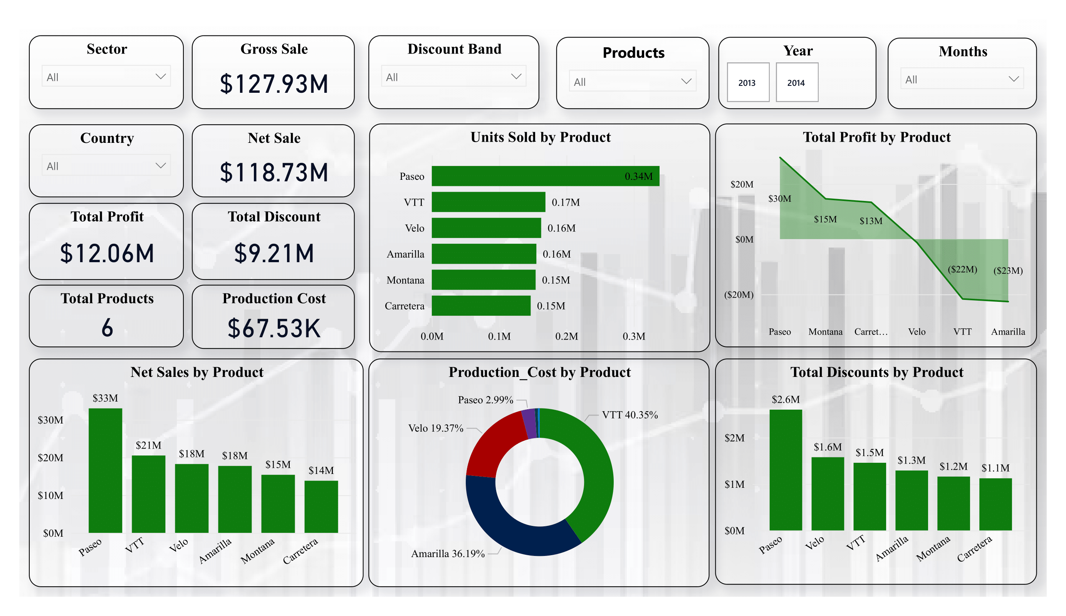

Slide 5
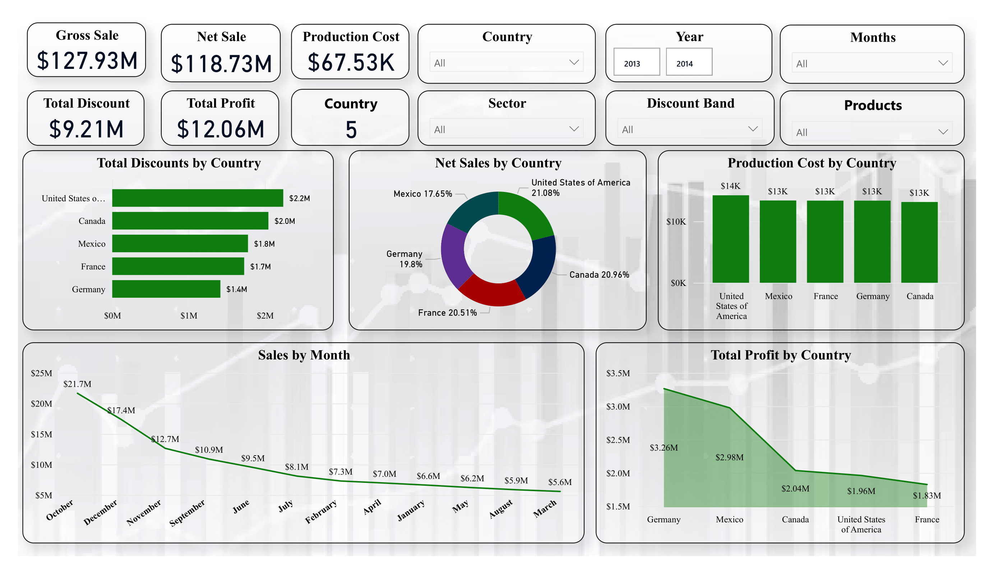

Slide 6
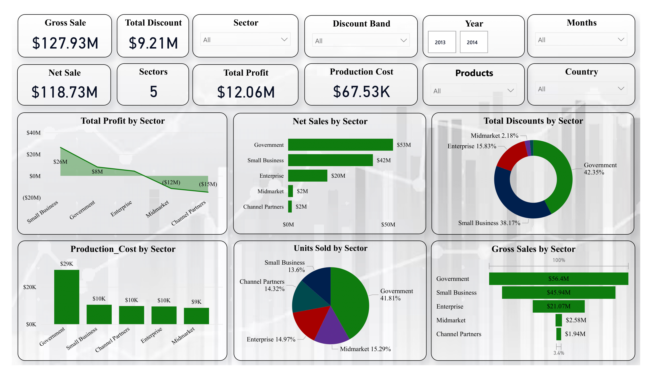

Slide 7
Insights
Product Sales Analysis
Paseo: Leads with 0.34M units sold and $33M in net sales. However, high production costs(2.99%)and discounts($2.6M) impact profitability.
VTT and Amarilla: Despite decent sales, both products have negative profits(-$22M and -$23M respectively) due to high production costs(VTT at 40.35%, Amarilla at 36.19%) and significant discounts.
County Sales Analysis
United States and Canada lead in net sales with 21.08% and 20.96% respectively, but their profits are not proportionally high due to the higher discounts offered ($2.2M for the USA and $2.0M for Canada).
Germany has the highest total profit ($3.26M) with moderate production costs and discount levels.
Sector Sales Analysis
Government Sector: Leads in gross sales($56.4M) but shows low profits.
Small Business Sector: Although this sector has the second-highest net sales ($45.94M), the profit margin is higher than the government sector, making it a more profitable focus.

Slide 8
Insights
Monthly Sales Analysis
October is the peak sales month with $21.7M in sales. However, there is a noticeable drop in sales towards March, which only recorded $5.6M.
Understanding seasonality and market demand could help stabilize sales across the year.
Production Cost and Discounts
High Production Costs are seen in VTT (40.35%) and Amarilla (36.19%), leading to low profitability. A cost reduction strategy is recommended.
Discount Strategy: Paseo has the highest discount given ($2.6M). Reassessing discount strategies across all products could significantly impact profit margins.

Slide 9
Recommendations
Optimize Product Focus:
Prioritize profitable products like Paseo while working to reduce costs and discounts for VTT and Amarilla.
Reevaluate Discounts:
Adjust discount strategies to improve profit margins, particularly for products like Paseo with $2.6M in discounts.
Reduce Costs:
Focus on reducing high production costs for VTT (40.35%) and Amarilla (36.19%).
Expand in Profitable Markets:
Leverage strong performance in Germany ($3.26M profit) to explore and expand in similar markets.
Boost Low Sales Months:
Implement targeted promotions or new product launches to increase sales during low-performing months like March ($5.6M in sales).
Sector Strategy:
-Focus on the Small Business sector, which is generating $45.94M in net sales with a healthy profit margin. Reconsider strategies for the Government and Channel Partners sectors to enhance profitability.

Slide 10
Conclusion
The data highlights key areas for improvement in profitability. Paseo is a strong seller but needs cost and discount optimization. VTT and Amarilla are underperforming due to high costs and discounts, requiring immediate attention. Germany is the most profitable market, indicating the potential for expansion, while the Government sector needs a strategy review despite its high sales. Addressing these areas and stabilizing seasonal sales can drive sustainable growth and maximize profits.

